Slide 1
Signal Range Problem
Steven Towns, Collin Neal, Zakaria El-Awadi

Slide 2
Identify the Problem
Problem:
We were given the task to find the range of various signals towers in a city.
The towers are suppose to be arranged in a horizontal order (no specific order)
Where signal distance is measured by the leftward range (due to tower height)
Constraints:
We could have a maximum of 10 test cases.
There can be anywhere from 2 to 10^6 towers.
The height of each tower can reach a maximum of 10^8.

Slide 3
Overall Goal
Goal: Find the fastest and most efficient way to calculate the range of each tower that is being tested.

Slide 4
Evaluation of Complexity
Upon first glance we saw that a list could be used to implement a solution however, after analysis we concluded that the implementation of a Stack (ADT) is a more efficient means of solution.
Stack’s have a complexity of O(n), which is faster than using a regular list which would have a O(n²).

Slide 5
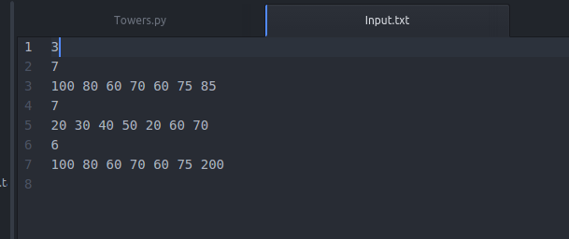
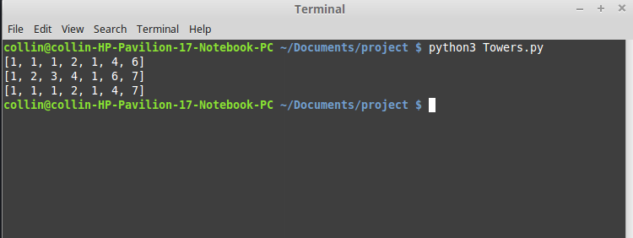
Examining the I/O
Number of cases
The number of towers
Input of tower heights
The output for case 1

Slide 6
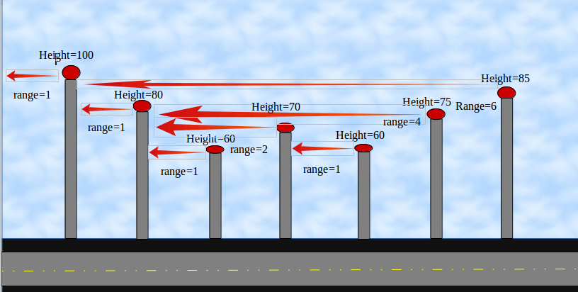
Visualizing the result

Slide 7
Reflection
Was the problem identified and stated, along with constraints?
Yes
What data structure was implemented to solve the problem?
A stack
What was the complexity of solution?
O(n)

